Slide 1


Financial Reporting Role
Module 3
Next

Slide 2

Five Modules
Audit Committee Training on roles of the audit committee
General Purpose and Function
External Auditor Function
Financial Reporting Function
Alleged Wrong-doing Function
Risks and Internal Control Function
Back
Next
Notes:
Refer to handout – agenda
What defines an audit committee?
Importance of an audit committee
What is an audit committee?
Audit committee terms of reference/policy
Audit committee composition
General audit meeting requirements
Highlight audit committee’s responsibilities
Audit Committee Challenges
Dependence on expertise and integrity
Quality of auditor services
Compliance programs and communication
Role and Relationship with External Auditor
Know the legislative audit deadlines and requirements
Identify items to consider when recommending an external auditor and plan
Gain an awareness of what the external auditor will provide
Evaluating auditor services
Financial Statement Review
Building knowledge of financial statements
Importance of analysis and questions
Potential red flags
Financial analyses linkage to Financial Condition Indicators
Risk, Fraud and Internal Control
What is fraud?
What is the impact on an organization?
Does the organization have weak controls?
How does the audit committee obtain assurance?
What is an effective internal control system?
Tone at the top
What is internal control?
What is risk?
What is the audit committee’s role regarding internal control letters?
Compliance and Ethics
Responsibilities for ethical behavior
Culture of Compliance
Other legislative compliance requirements
Audit Committee Reports and Assessments
What are audit committee’s reporting requirements?
Why do an audit committee self-assessment?

Slide 3
3
What Is Your Role Regarding the Financial Reporting Function?
    Review the audited financial statements;
    Review any changes in accounting principles and practices with management;
    Review any significant variances in comparison to prior year and/or budget; and
    Review and discuss the Financial Condition Indicators (FCIs).
Back
Next
Notes:
FRAM outlines the following specific responsibilities related to the work of the external auditor:
The Committee shall:
discuss the extent, timing and completion of the audit including the level of materiality to be used;
review estimated and final audit fee;
discuss whether the terms of the letter of engagement were met;
recommend to council or village commission the change of the municipal auditor if management questions the competence of the incumbent auditor and the committee confirms the view; the recommendation to appoint a new auditor would follow an adequate inquiry into the auditor's competence and reputation;
review the problems and restrictions encountered by the auditor and degree of cooperation received; and
promote cooperation between the management and the auditor.

Slide 4

Financial Statements
  Building knowledge of financial statements;
  Know the importance of analyses and key questions;
  Gain awareness of potential red flags;
  Understand the link between financial analyses and financial condition indicators; and
  Understand Committee’s role
Role in reviewing financial statements
Back
Next
Notes:
In

Slide 5
5
What is the Purpose?
    Demonstrate accountability and transparency to citizens
    Fulfill legislated requirements
    Aid in effective long-term planning
    Provide a snapshot in time
Back
Next

Slide 6

Information You Should Receive
6
From the External Auditor:
Audit opinion
Set of Audited Financial Statements
  Statement of Financial Position;
  Statement of Operations;
  The Statement of Remeasurement Gains and Losses;
  Statement of Changes in Net Debt;
  Statement of Cash Flow; and
  Notes / supplementary schedules.
Management/Internal Control Letter
Potential additional analyses/feedback
From Management
Management Representation Letter
Responses to the internal control issues noted.
Back
Next
Notes:
Set of Audited Financial Statements
complaint with Chartered Professional Accountants of Canada’s Public Sector Accounting Standards; and
include any additional notes required per Municipal Government Act and regulations
Management/Internal Control Letter in the format per Municipal Government Act‘s regulations.

Slide 7
7
What Standards?– Auditor’s Opinion
    Canadian Public Sector Accounting Board’s standards
    Municipal Government Act regulations ‘Financial Reporting and Accounting Manual” (FRAM)
Back
Next

Slide 8
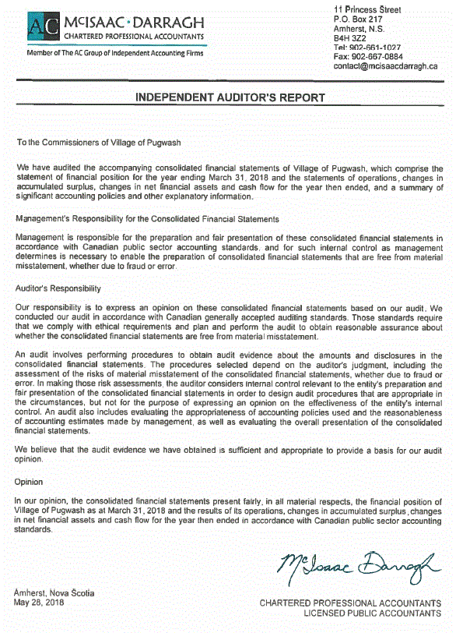

Independent Auditor’s Report
Outlines the Standards–
Management’s Responsibility
Level of Assurance
Audit Opinion
Back
Next
Notes:
Outlines the Standards–
statements, what information those financial statements should report, when it should be reported and how as well as the required notes.
It dictates the basis of the accounting used in compiling a government’s accounting records because the accounting system must be able to generate the financial information needed to meet the requirements of the model.
The basis of accounting can prescribe method of accounting such as cash or accrual that specifies when revenues expenses assets and liabilities should be recognized in the financial statements.
The MGA act an…..
PSAB is short for Public Sector Accounting Board of the CPA which has the authority to set accounting standards for public sector (As GAAP is for the private sector)
FRAM – Financial Reporting and Accounting Manual is a regulation of MGA, this regulation provides the system of accounting that is to be used by municipalities and village, the manual financial statements be prepared in accordance to PSAB standards
Statements –Canadian Public Sector Accounting Standards (PSAB)
Auditor – Canadian generally accepted auditing standards
Management’s Responsibility– the statements are the product of the Commission
Level of Assurance
Audit Opinion on the fairness of the presentation of the financial statements

Slide 9

Audit Opinion
9
Based on a standard - Compliant with Chartered Professional Accountants of Canada’s Public Sector Accounting Standards
The opinion may be:
Unqualified – the auditor has determined that the statements are presented in conformity with established standards;
Qualified – the auditor has identified one or more specific issues regarding the financial statement preparation;
Adverse – the auditor has identified significant issues in the preparation or accuracy of the consolidated financial statement; or
Denial – the auditor is unable to examine enough information to form an opinion.
Back
Next

Slide 10
10
Key Questions – Auditor’s Opinion
    Were the financial statements prepared in accordance with Canadian public sector accounting standards?
    Did the auditor issue an unqualified opinion on the financial statements?
Back
Next

Slide 11
11
The Financial Statements
Review each statement
Look at key questions
Look at the financial condition indicator in relationship to the statement
Back
Next

Slide 12

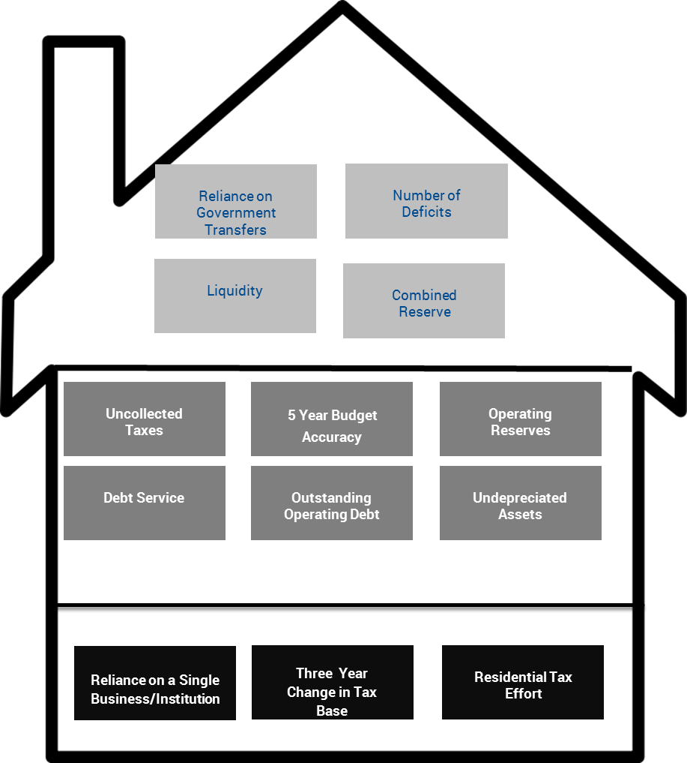
12
Additional Supporting Information and Analyses
Financial Condition Indicators
13 Indicators
Organized into 3 dimensions
Risk threshold for each Indicator
Graphically presented in ‘House’ format
Back
Next

Slide 13

Statement of Financial Position
    Financial Assets
    Liabilities
    Non-Financial Assets
    Accumulated Surplus
Overarching Statement
Back
Next
Notes:
Statement of financial position describes the municipality’s financial position in terms of assets and liabilities at the end of the fiscal year. The difference between the assets and liabilities is referred to as net debt or accumulated surplus.
Payable (Money owed); Accruals (the obligation has occurred); Deferred revenue (received money but have not fulfill the obligations) Employee Pension Obligations

Slide 14
14
Statement of Financial Position
    Overarching statement
    Changes are summarized in the other statements
Back
Next
Notes:
This is the overarching statement that summarizes an entity’s financial position at a point in time. Changes in the financial position of the entity are summarized in the following four statements.

Slide 15
Financial Assets
Current cash resource
Receivables
Investments
Assets expected to be converted into cash or to generate cash
Effectiveness of Tax Collection
Cash Position
Ability to address unforeseen costs
Back
Next
Notes:
Financial assets are the financial resources an entity controls and can use to pay what it
owes to others. These assets include cash, accounts receivable, investments, and assets
that are convertible to cash or that generate cash so that the entity can pay its liabilities
as they come due.
Information about the liquidity of an entity’s financial assets is not presented on the
Statement of Financial Position. (Liquidity means how quickly assets can be used to
pay bills.) However, the notes to the financial statements include disclosures on the
liquidity of an entity’s financial assets.

Slide 16
Key Questions
Has the Cash position decreased significantly from previous years?
What is the cash position? Does the municipality have enough cash to pay bills as they come due? (Low liquidity can indicate a cash flow problem and may indicate a concern in other areas such as revenue collection.)
How effective is the tax collection?
What is the organization’s ability to address unforeseen costs? Is there sufficient reserves to address unexpected events or provide flexibility to address future projects/obligations.
Back
Next
Notes:
In

Slide 17

Liabilities
Payable (money owed)
Accruals (the obligation has occurred)
Deferred revenue (received money, but obligations unfulfilled)
Employee Pension Obligations
Back
Next
Notes:
Liabilities are by main classification: payable, accruals or deferred revenue for example
Liabilities are existing financial obligations to outside parties at the date of the financial
statements. They result from past transactions and events and will lead to the future
sacrifice of economic benefits (e.g., financial assets).
Common liabilities are accounts payable, debt, employee pension obligations, and
unearned revenue. Users should also read the notes to the financial statements to better
understand the nature of an entity’s liabilities and when liabilities are due.

Slide 18
Key Questions
What do we owe?
Level of debt
  Long-term and short-term
Back
Next
Notes:
In

Slide 19
Non-financial Assets
Prepaid expense (an expense paid before obligation realized)
Inventory
Tangible Capital Assets (net book value) e.g., truck actual cost minus accumulated amortization (spreading the cost of the truck over the life of the truck).
Back
Next
Notes:
Non financial assets are divided by main classification categories – prepaid expenses, inventories (held for consumption) and tangible capital assets.
Non-financial assets are assets that an entity will use up when providing future services to the
public. These assets are not normally used by an entity to settle its liabilities with external
parties. As a result, they are shown separately in the Statement of Financial Position.
Often, the most significant group of assets within this category are tangible capital
assets, like buildings or roads, which are acquired to provide services over many years.
As entities deliver services, the estimated portion of the assets used is recorded as
an expense in the Statement of Operations. The balance presented represents the
remaining service potential of the non-financial assets.
Crown lands and natural resources inherited in right of crown and all intangible
assets are not recognized as assets in public sector financial statements. When these
assets are important to an entity’s ability to generate revenues or deliver services,
additional information should be included in either the notes to the financial
statements or in the financial statement discussion and analysis accompanying the
financial statements.

Slide 20
Key Question
Condition of assets
Back
Next
Notes:
In

Slide 21

Accumulated Surplus
Financial assets + Non-financial assets - Liabilities = Accumulated surplus
Financial Statement Note: The note identifies the portion of the accumulated surplus that is:
unrestricted;
restricted (can only be used for a pre-determined purpose); and
tangible capital asset.
Indicator – financial resource available for future services
Back
Next
Notes:
net‐debt position does not necessarily mean the local government is in financial difficulty. It
simply means the local government has more liabilities than financial assets. However, a viable debt
management plan needs to be in place to ensure that debt is sufficiently funded and that municipal
Services are not jeopardized.

Slide 22
22
Key Questions – Financial Position
    Is net debt or net financial asset position increasing or decreasing?
    Is the accumulated surplus or deficit increasing or decreasing?
    What investment has been made in tangible capital assets for providing future services?
Back
Next

Slide 23
Statement of Operations
    Revenue
    Expenses
    Annual Surplus or Deficit
    Information about the revenues and expenses for the reporting period
Back
Next

Slide 24
24
Revenue
Earned
By Source
Note: The main source of revenue is property assessment rate.
Back
Next
Notes:
Revenue – is an accounting of all local government earnings in a given year. The main sources of local
government revenue are property taxation and user fees collected for services such as garbage
collection or recreation facilities. Government transfers are another revenue source – in the revenue
section they include line items for federal, provincial or other regional government grants provided to a
local government for operating and /or capital purposes.
Most revenue listings include a line item specifically for other revenues. This generally includes such
revenues as contributed assets, which are normally tangible capital assets that have been donated or
transferred to a local government from a developer or outside organization. Contributed assets are
reported as revenue on the Statement of Operations because they create an expected future economic
benefit, and result in an increase in a local government’s year‐end accumulated surplus. Although
contributed assets are reported as revenue, they do not represent cash received by a local government.

Slide 25
Revenue
Key questions regarding revenue
How dependent is the organization on transfers to meet operating costs?
How did actual results for revenues compared to budget and prior years?
Is there any other dependence/vulnerability?
How stable is the revenue? Has the revenue growth matched the cost of living?
What is the flexibility to increase if required?
Is there enough annual revenues to cover operating expenses?
Back
Next
Notes:
In

Slide 26
26
Expenses
By Function (standard functions)
Not all expenses are based on cash transaction. For example, amortization expense is the cost of the use of that asset for stated timeframe (period).
Back
Next

Slide 27
27
Annual Surplus
Revenue - expenses
Note: This amount is added to the accumulated surplus.
Back
Next

Slide 28
Key Questions
How did actual results for expenses compared to budget and prior years?
How effectiveness was the expenditure management
How successful was the organization in maintaining a balance budget?
Was the annual deficit or surplus impacted by an unusual or non-recurring event?
Is the accumulated surplus or deficit of the entity increasing or decreasing?
Back
Next
Notes:
In

Slide 29

Statement of Cash Flow
    Operating
    Capital
    Investing
    Financing
Details the sources of cash and how you use the cash….the flow
Back
Next
Notes:
This statement is commonly called changes in net debt or accumulated surplus.
The statement tracks municipality’s expenditures used to acquire tangible capital assets (e.g. new
vehicles) and pay for its inventories of supplies during the reporting period. The disposal of tangible
capital assets, and the use of inventory and prepaid expenses (such as insurance paid at the beginning of
the year and used during the year) are also captured in the statement of changes in net debt.

Slide 30
Operating Transactions
      Includes:
      Annual surplus; and
      Changes in inventory
Capital Transactions
      Includes:
      Expended on capital assets; and
      Received selling an asset.
Financing Transactions
      Includes:
      Funds received from long-term debt financing; and
      Long-term debt principal repaid.
Investing Transactions
      Includes:
      Increases or decreases in temporary or long-term investments. An example is interest earned on a bond.
30
Back
Next

Slide 31
31
Key Questions – Cash Flow
    Is the direct or indirect method to prepare the Statement of Cash Flow used?
    Was there sufficient cash flow from operations to cover all of the cash requirements?
    Is there excess cash that could be used to pay down the debt or transfer to reserves?
Back
Next

Slide 32

Statement of Change in Net Debt
    Reconciles the change in net debt for the current and prior year
Back
Next
Notes:
Statement of financial position describes the municipality’s financial position in terms of assets and liabilities at the end of the fiscal year. The difference between the assets and liabilities is referred to as net debt or accumulated surplus.

Slide 33
33
Back
Next
Notes:
This statement is commonly called changes in net debt or accumulated surplus.
The statement tracks municipality’s expenditures used to acquire tangible capital assets (e.g. new
vehicles) and pay for its inventories of supplies during the reporting period. The disposal of tangible
capital assets, and the use of inventory and prepaid expenses (such as insurance paid at the beginning of
the year and used during the year) are also captured in the statement of changes in net debt.
To assess the impact of a net debt position on the financial health of a local government, consider the
following:
• Is there a debt management plan in place?
• What is the term of the debt?
• What portion of the local government’s liability servicing limit does the net debt represent?
• Are the local government’s financial assets liquid and current?
• What portion, if any, of the local government’s financial assets are restricted?
• What portion of the net debt is funded by the annual tax levy? By user fees?
• Will projected future revenues be sufficient to pay the net debt?
If the answers to these questions are favorable, a local government is not likely

Slide 34
34
Key Questions – Statement of Change in Net Debt
    How did actual spending on capital assets compare to capital plan?
    What investment has the entity made in tangible capital assets for providing future services?
    How were current expenditures financed?
    Is the net debt or net financial asset position increasing or decreasing?
Back
Next

Slide 35

Statement of Remeasurement Gains and Losses
    Opening position
    Current changes in remeasurement gain or losses by type
    Gain or losses realized in the year and transferred to the statement of operations
    Ending balance
Gains and losses until the asset or liability is disposed or settled.
Back
Next
Notes:
Statement of financial position describes the municipality’s financial position in terms of assets and liabilities at the end of the fiscal year. The difference between the assets and liabilities is referred to as net debt or accumulated surplus.
Payable (Money owed); Accruals (the obligation has occurred); Deferred revenue (received money but have not fulfill the obligations) Employee Pension Obligations

Slide 36
36
Key Questions – Remeasurement Gains and Losses
    Why do the financial statements not include a Statement of Remeasurement Gains and Losses?
    What is the potential exposure to future fair value or foreign currency exchange?
Back
Next

Slide 37
Notes
  Notes provide:
    financial statement’s bases;
    more detail regarding items in the financial statements;
    Information on what is not recognized; and
    details regarding future obligations.
Provide a variety of information on the organization’s current and future obligations and performance.
Integral part of the financial statements
Requirement
Back
Next
Notes:
This statement is commonly called changes in net debt or accumulated surplus.
The statement tracks municipality’s expenditures used to acquire tangible capital assets (e.g. new
vehicles) and pay for its inventories of supplies during the reporting period. The disposal of tangible
capital assets, and the use of inventory and prepaid expenses (such as insurance paid at the beginning of
the year and used during the year) are also captured in the statement of changes in net debt.

Slide 38
38
Notes and Schedules
    Reporting Entity
    Significant Accounting Policies
    Receivables
    Payables
    Deferred revenue
    Pension plans and other employee benefit obligations
    Commitments (contractual obligations)
    Contingencies
    Debt Repayment
    Accumulated surplus(debt)
    Segment disclosure by objects
    Estimates and measurement uncertainty
    Subsequent events
    Remuneration and expense schedule
    Amortization Schedule
Back
Next

Slide 39
39
Key Questions – Notes
    Have the accounting policies changed?
    Is the unrestricted portion of the accumulated surplus in a deficit position?
    What is the potential exposure to contingent liabilities?
    What is the potential exposure due to guarantees?
    What is the condition of the employee pension plan? (especially if there is a defined benefit plan)?
    What amount of funds are required to be set aside to cover the future debt interest and repayments obligations?
    What reserves have been set aside for future obligations or infrastructure needs?
    Do the expenses of reportable person appear reasonable?
Back
Next

Slide 40


Potential Warning Signs:
What are some potential warning signs?
Not meeting reporting deadlines;
Cash position has decreased significantly from previous years;
Amount of cash and cash equivalents is less than the amount of restricted surplus;
Net financial assets reported has significantly decreased or the net debt has significantly increased;
Unrestricted portion of the accumulated surplus is in a deficit position;
Less than seven Financial Condition Indicators deemed low risk;
Reserves are low; and
Debt service ratio and expense to revenue ratio is above 100%.
Back
Next

Slide 41

Overall Goal
Is the municipality able to meet current and future needs in a balance and independent manner.
Back
Next

Slide 42
The Roof
THE KPIs (ROOF) INDICATORS:
Liquidity -Cash position (Ability to meet current needs)
Combined Reserve -Ability to have funds for future capital projects/assets (Ability to meet future needs)
Number of Deficits Success in maintaining balance budget (In a balance manner)
Reliance on Government Transfers - Any dependence (Independent manner)
Back
Next
Notes:
The key performance indicators are located at the roof or top of the house. Four indicators measure the achievement of the overall objectives for assessing financial sustainability. The Indicators answer the question - Is the municipality able to meet current and future needs in a balance and independent manner.

Slide 43
What
What I do with this
information?
Roof
Structure
Back
Next
Base

Slide 44
What does the
colour mean?
How do I interpret the results?
Individual risk thresholds
Risk level:
  Low risk - green;
  Moderate risk- yellow; or
  High risk- red.
For example, the range for uncollected taxes is:
  Less than 10% is low risk,
  10% to 15% is moderate risk
  Greater than 15% is high risk
Back
Next
Notes:
Each Indicator’s results are compared to a threshold range. Thresholds are based on jurisdictional best practice and municipal reviews. The threshold range is unique for each Indicator. Indicator’s range denotes a risk level:
Low risk - green;
Moderate risk- yellow; or
High risk- red.
A municipality’s Indicator’s placement within the threshold range, will determine the risk level (colour) assigned to that Indicator
For example, the range for uncollected taxes is:
Less than 10% is low risk,
10% to 15% is moderate risk
Greater than 15% is high risk
For the results shown on the left, this municipality’s uncollected taxes was 4.1%, which is in the low risk range. As a result the Indicator’s box is green.

Slide 45
45
RED INDICATORS – WHAT NEXT?:
Red = High risk
A municipality should focus on high risk first.
Next Steps:
Dig deeper in these risk area(s). It is important to answer the following questions:
  What is the likelihood and impact of the risk?
  Are there any mitigating factors?
  What is the cause? Any linkages?
How will this result impact or support the municipality’s strategic plan/direction?
Depending on the analysis, the municipality should focus mitigating actions or efforts to lower the risk threshold.
Back
Next
DMA – Municipal Finance Team

Slide 46
46
YELLOW INDICATORS – WHAT NEXT?
Yellow = Moderate risk
Next Steps:
After the red indicators - Dig deeper in these risk area(s). It is important to answer the following questions:
  What is the trend?
  What is the likelihood and impact of the risk?
  What is the cause?
  Are there any mitigating factors?
  How does this result align with, or support the municipality’s strategic plans?
Depending on the analysis, the municipality should focus on mitigating actions or efforts to lower the risk threshold or accept risk level.
Back
Next
DMA – Municipal Finance Team

Slide 47
Financial Condition Indicators
47
GREEN INDICATORS – WHAT NEXT?
Green = Low risk
What should a municipality do? Next Steps:
It is important to understand this strength:
  What is the main reason for the low risk(s)?
  Any linkages?
  How is the municipality trending?
  How can the municipality leverage this strength?
  How does this result align with, or support the municipality’s strategic plans?
Back
Next
DMA – Municipal Finance Team

Slide 48

The Quiz
  5 questions
Back
Next
Notes:
What happens if there is a disagreement between the auditor and management?

Slide 49

Which financial statement provides information on the accumulated surplus (deficit)?
  Statement of Financial Position
  Statement of Operations
  Statement of Changes in Net Debt
  Statement of Cash Flow
Back
Next

Slide 50

  Two statements will provide this information:
  Statement of Financial Position; and
  Statement of Operations.
Back
Next

Slide 51
Which of the following would be a key question to ask when reviewing the Statement of Operations?
How did actual results for revenues compared to budget and prior years?
How stable is the revenue? Has the revenue growth matched the cost of living?
What is the flexibility to increase if required?
Was the annual deficit or surplus impacted by an unusual or non-recurring event?
Back
Next

Slide 52
All would
It is important to ask questions.
Each question will focus on different components of the Operating Statement.
Back
Next

Slide 53
Financial statement notes do not provide any additional information on future obligations.
True or False
Back
Next

Slide 54
False
Notes to the financial statement can provide details on future liabilities and transactions; such as, future debt interest and principle repayments.
Back
Next

Slide 55
Which of the following may indicate a potential concern?
Not meeting reporting deadlines;
Cash position has decreased significantly from previous years;
Uncollected taxes has increased significantly from prior year.
Back
Next

Slide 56
All would
It is important to ask further questions and dig deeper into these areas.
Back
Next

Slide 57
Does a red Financial Condition Indicator mean I am in immediate danger?
True or False
Back
Next

Slide 58
False
Red indicates that a high risk has been identified. It is important to note that, through careful strategic planning and appropriate action, an indicator can strengthen or lessen the risk. Thus, it is critical that a municipality review the potential risks along with any relevant additional inquiry or analysis.
What should a municipality do?
Dig deeper in these risk areas. It is important to answer the following questions:
  What is the likelihood and impact of the risk?
  Are there any mitigating factors?
  What is the cause? Any linkages?
Depending on the analysis, the municipality should focus on mitigating actions or efforts to lower the risk threshold.
Back
Next
Notes:
Per the “Municipal Government Act” regulations 5(1)(b) municipalities and villages are required to appoint an auditor who is registered by the Department of Municipal Affairs.
No firm or partnership or person can act as, or exercise or perform any of the duties of, an auditor for a municipality or village unless they are registered as a municipal auditor pursuant to the provisions of Section 457 of the Municipal Government Act.

Slide 59

You have successfully completed Module 3.
You can now proceed to Module 4.
Back

